Slide 1

Graduation Project
Group : BEH1_DAT1_M1e
Data Analysis of Supply Chain
Ahmed Neamatallah
Ahmed Arram
Ahmed Refaat
Ahmed AbdElmegid

Slide 2
Agenda:-
Build Data Model, Data Cleaning and Preprocessing
Analysis Questions Phase
Forecasting Questions Phase
Visualization and Final Presentation

Slide 3


Slide 4
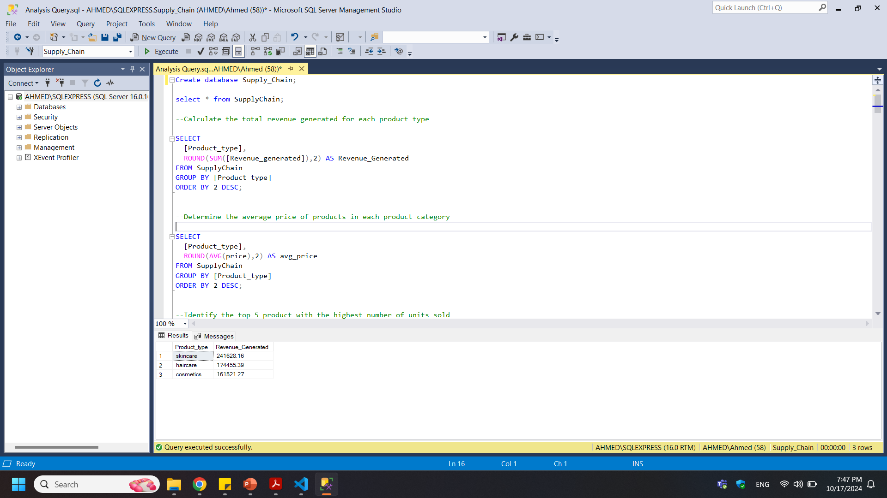

-- Calculate the total revenue generated for each product type

Slide 5


-- Determine the average price of products in each product category

Slide 6
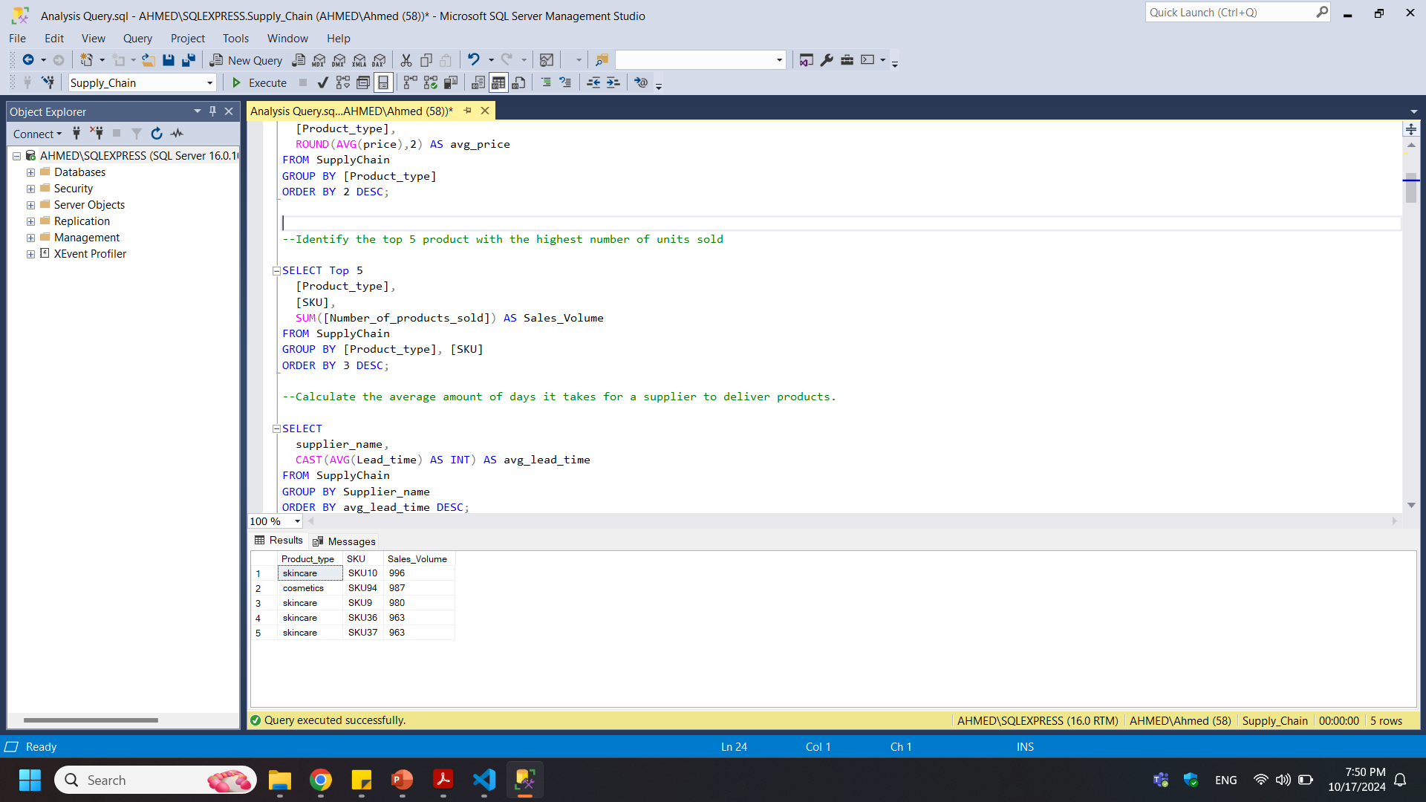

-- Identify the top 5 product with the highest number of units sold

Slide 7
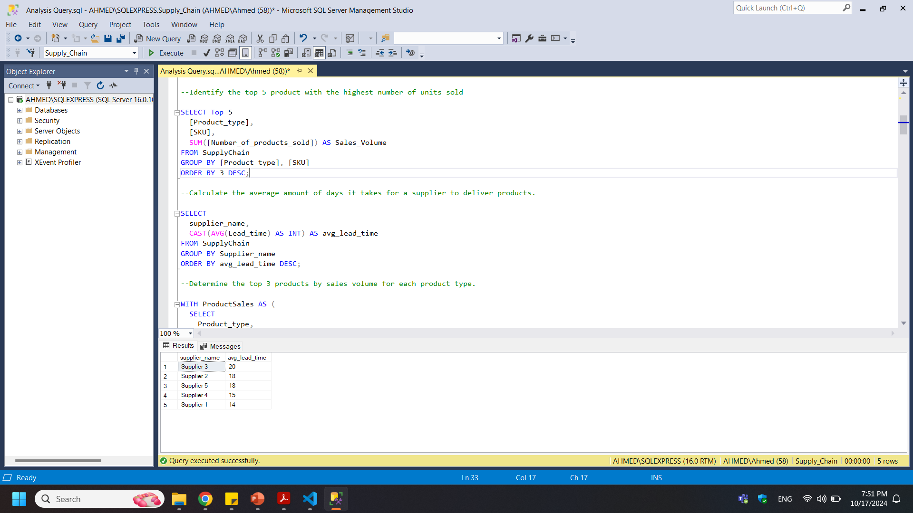

-- Calculate the average amount of days it takes for a supplier to deliver products.

Slide 8
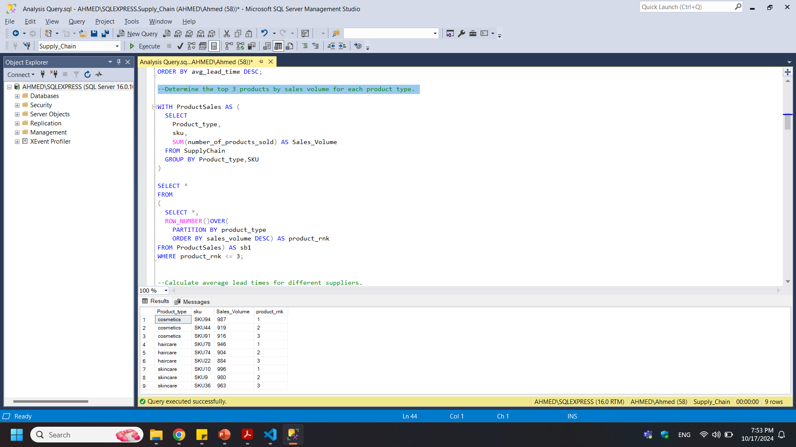

-- Determine the top 3 products by sales volume for each product type.

Slide 9
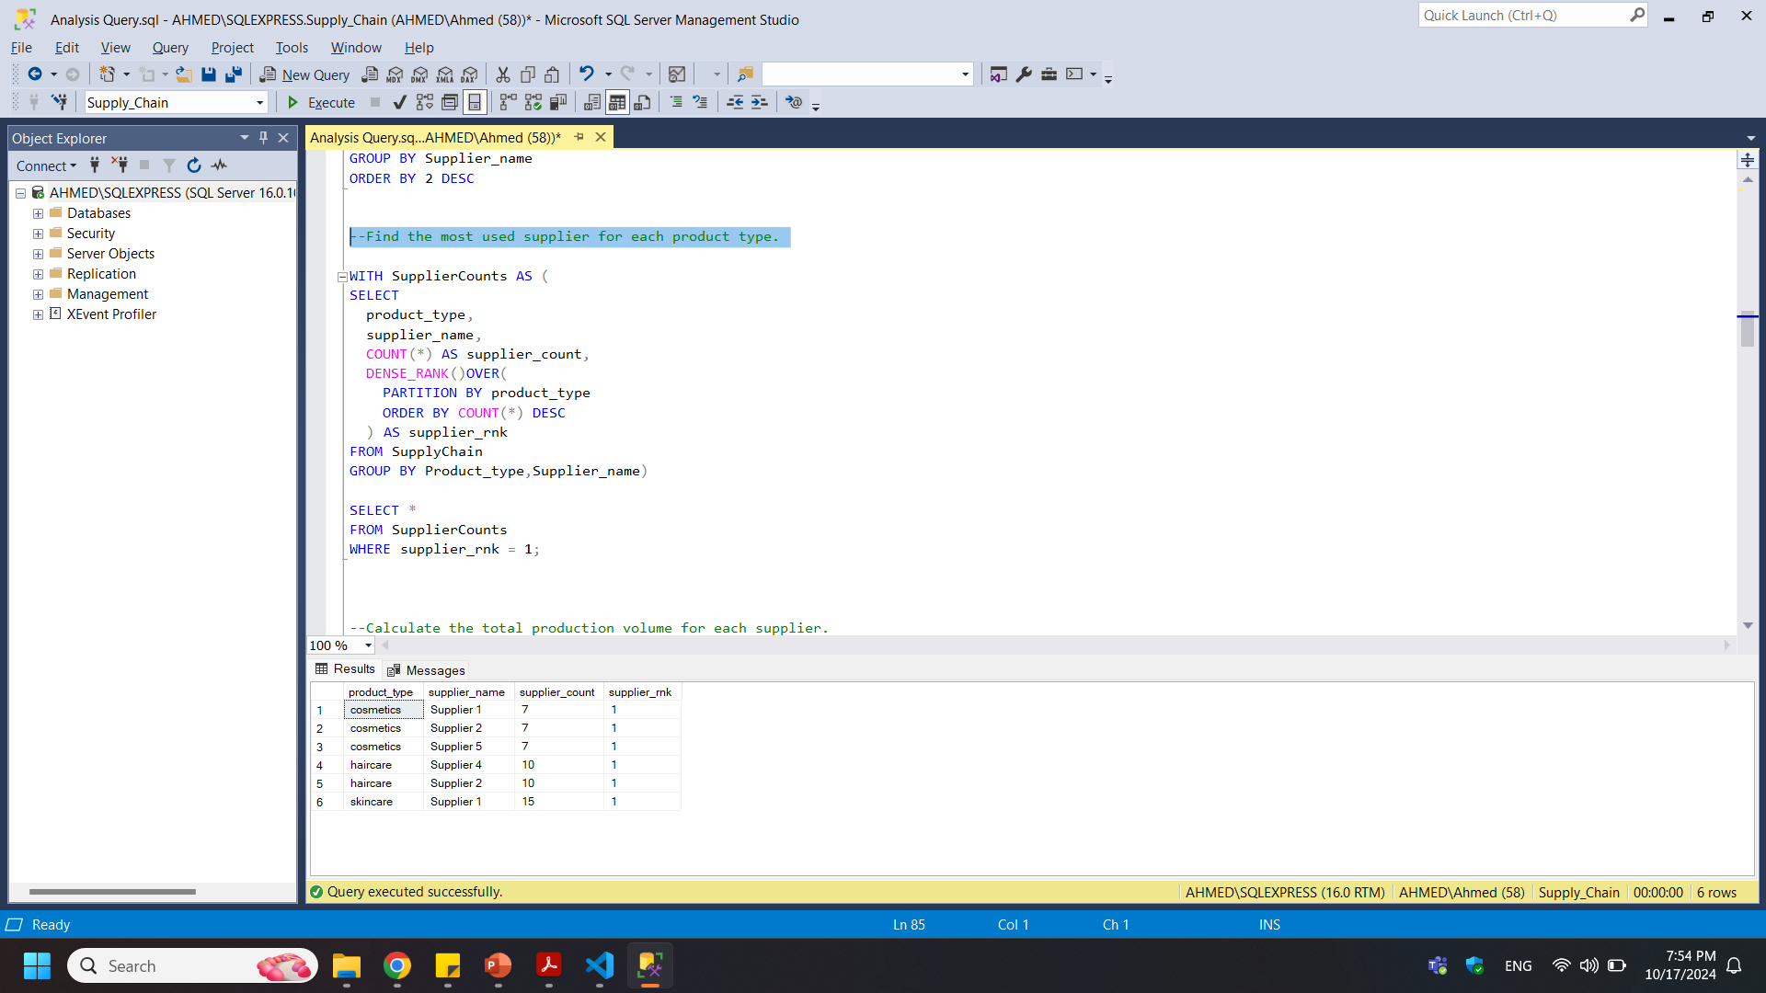

-- Find the most used supplier for each product type.

Slide 10
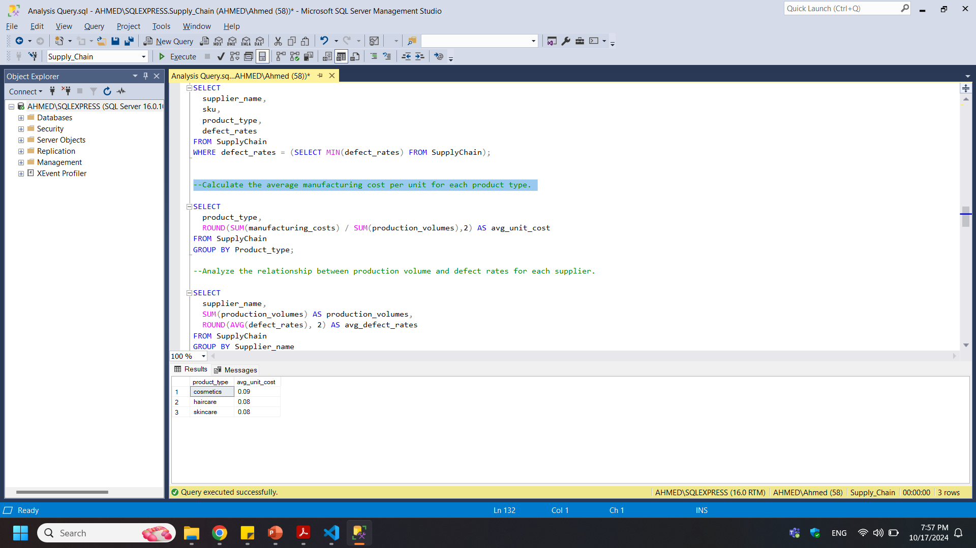

-- Calculate the average manufacturing cost per unit for each product type.

Slide 11
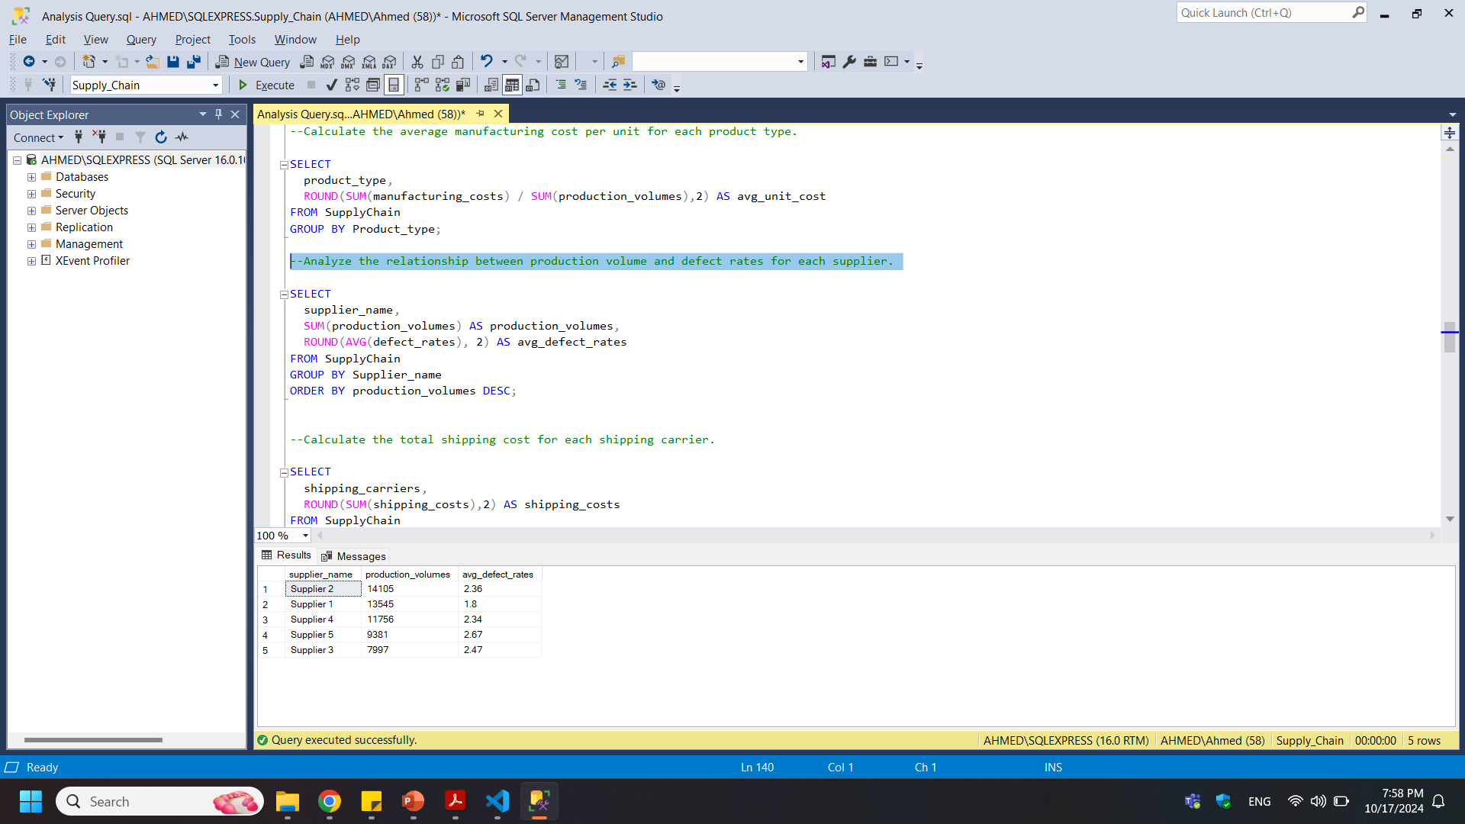

-- Analyze the relationship between production volume and defect rates for each supplier.

Slide 12
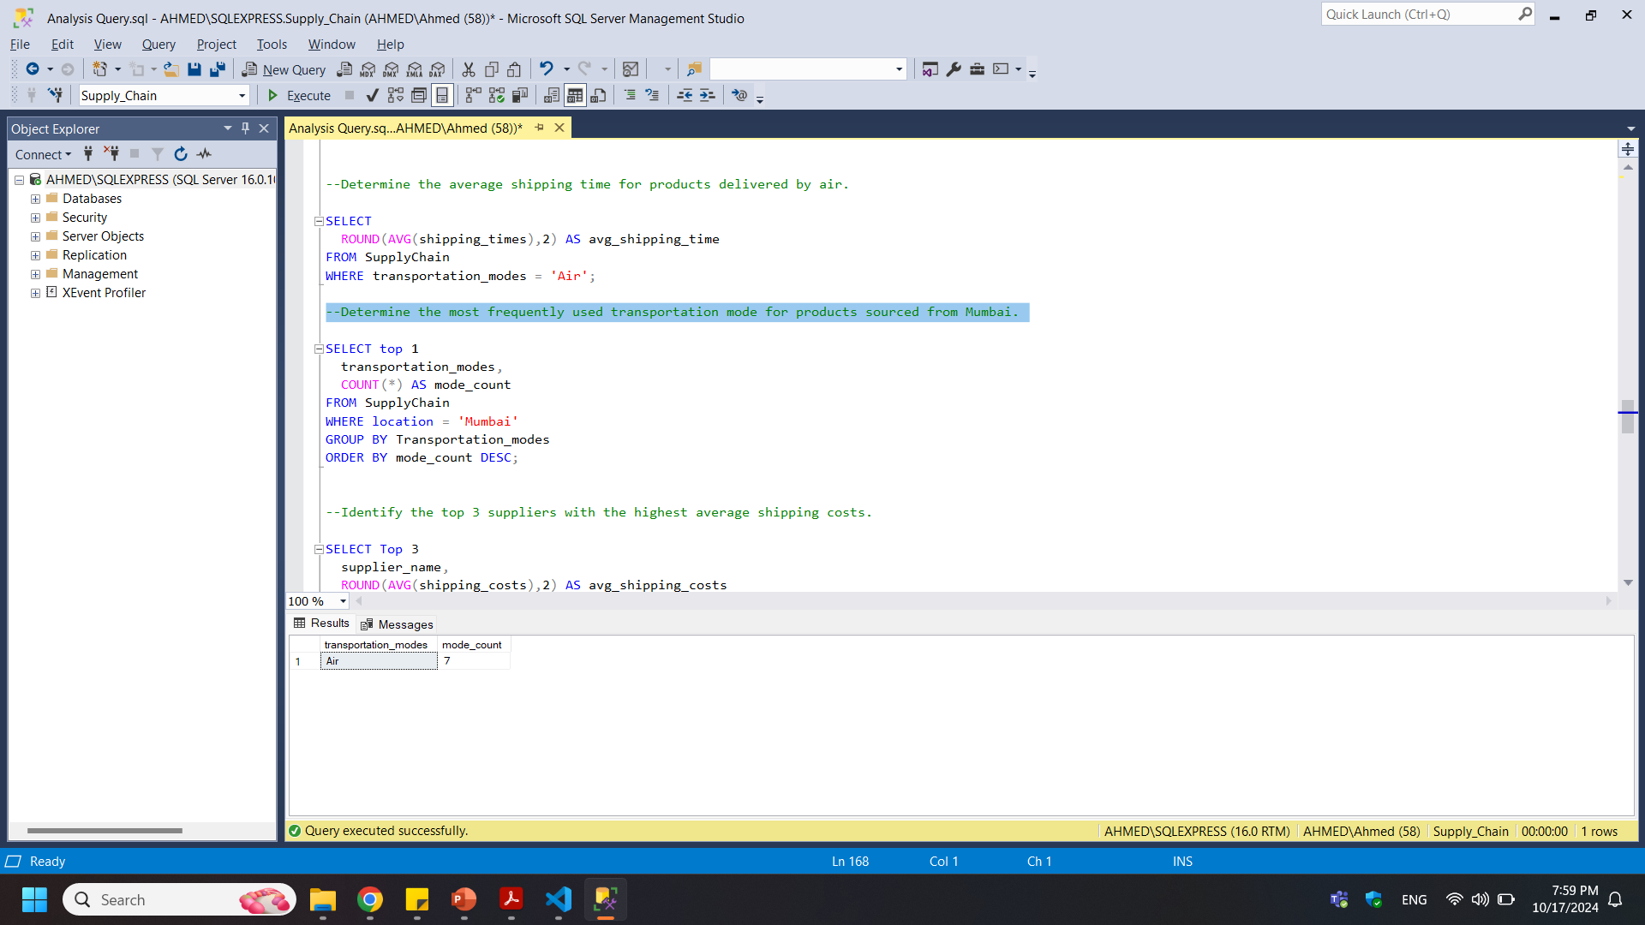

-- Determine the most frequently used transportation mode for products sourced from Mumbai.

Slide 13
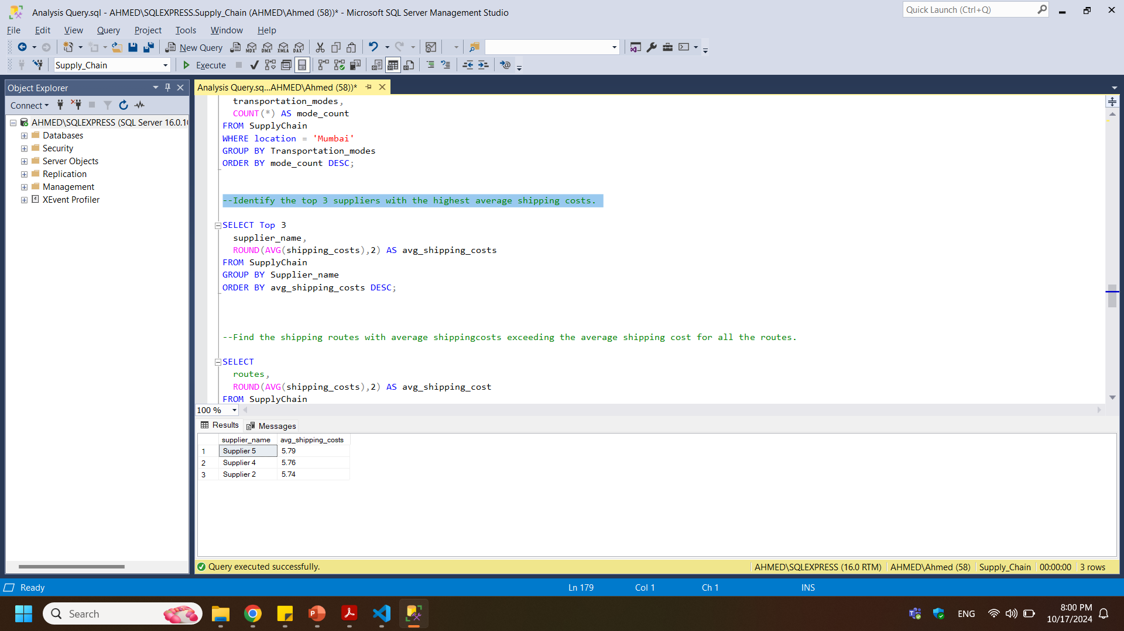

-- Identify the top 3 suppliers with the highest average shipping costs.

Slide 14
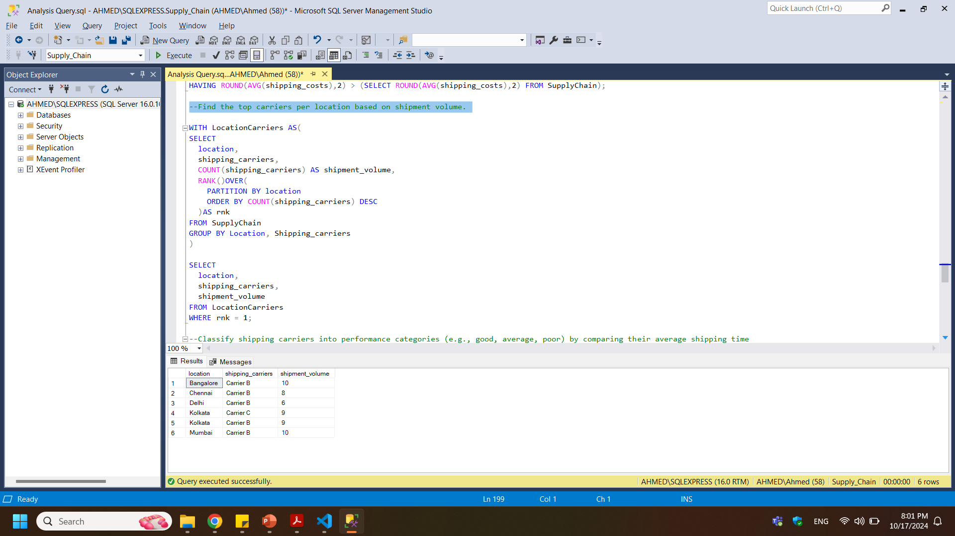

-- Find the top carriers per location based on shipment volume.

Slide 15
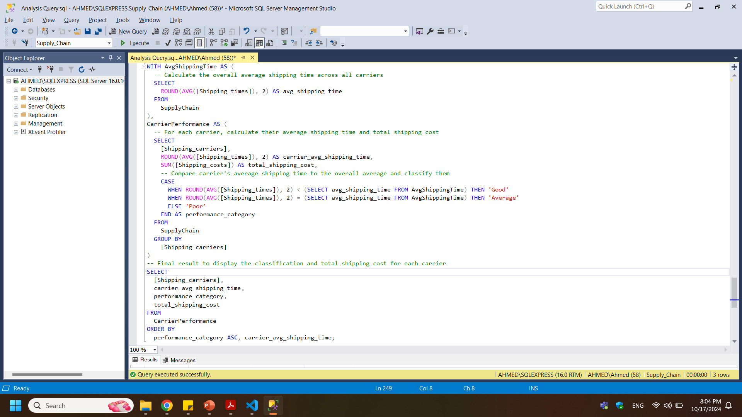
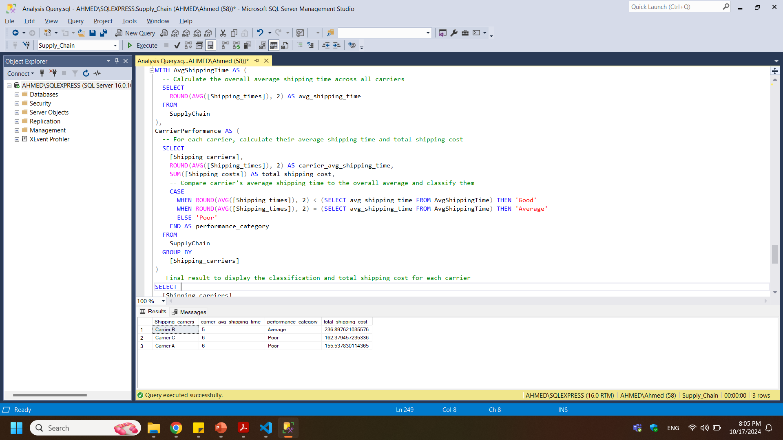
-- Find the top carriers per location based on shipment volume.

Slide 16


Slide 17
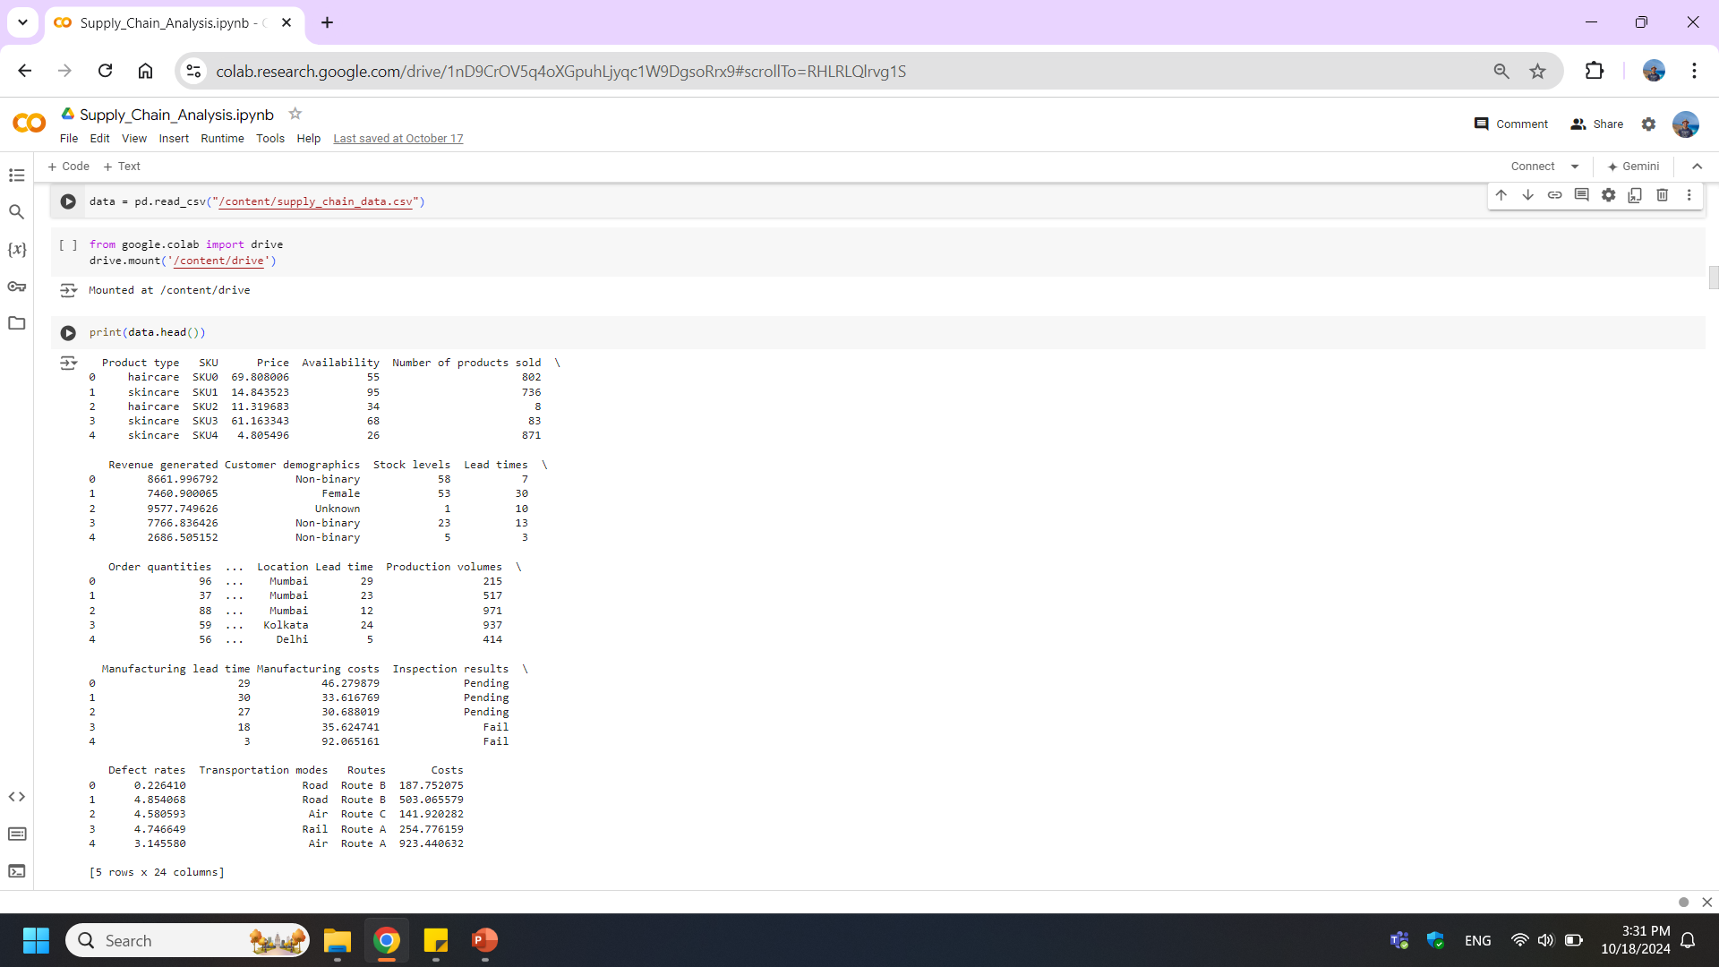
-- Read data --

Slide 18
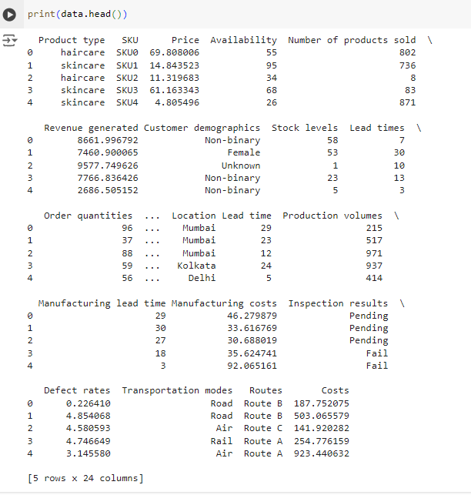
-- Print data head

Slide 19
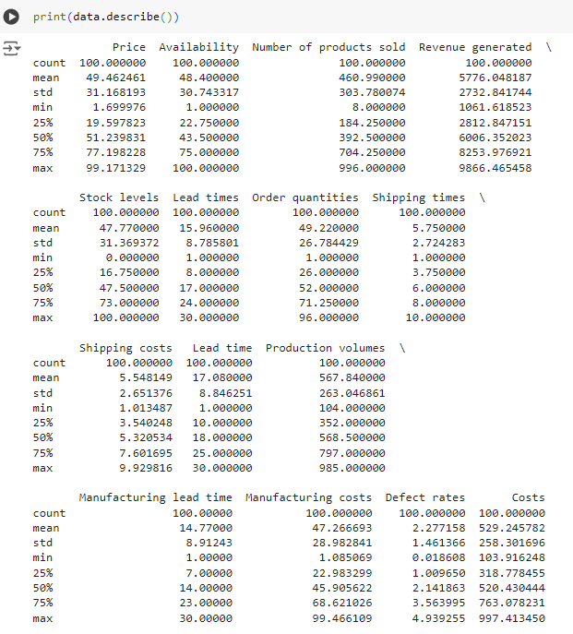
Descriptive Statistics

Slide 20
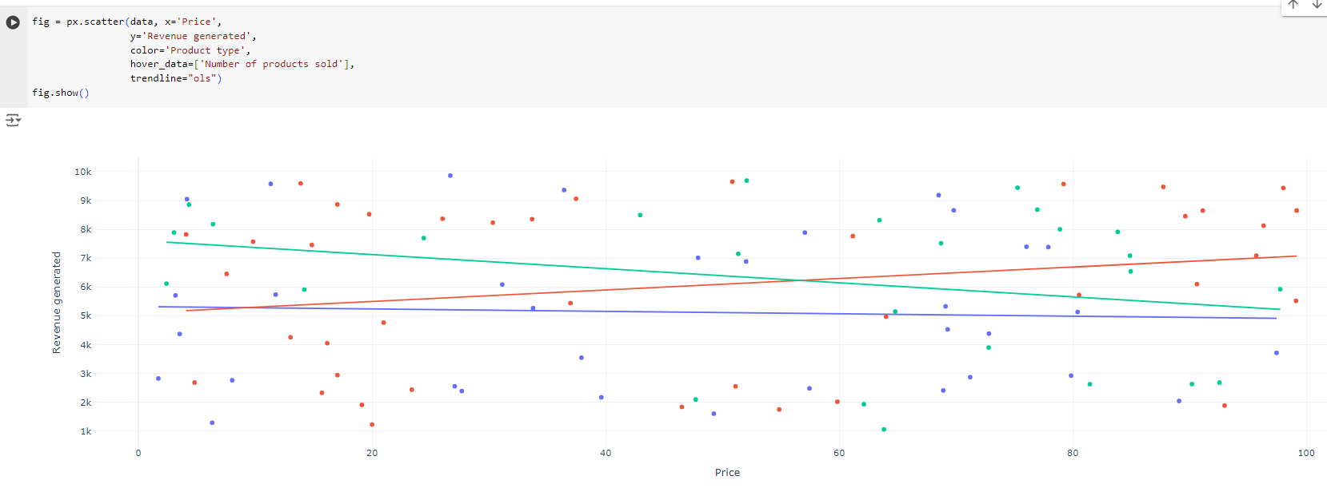
Product type and Price
Analyzing the Supply Chain by looking at the relationship between the price of the products and the revenue generated by them:

Slide 21
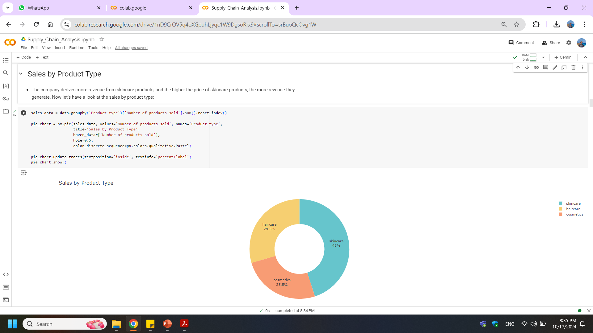

Sales by Product Type
The company derives more revenue from skincare products, and the higher the price of skincare products, the more revenue they generate. Now let’s have a look at the sales by product type

Slide 22
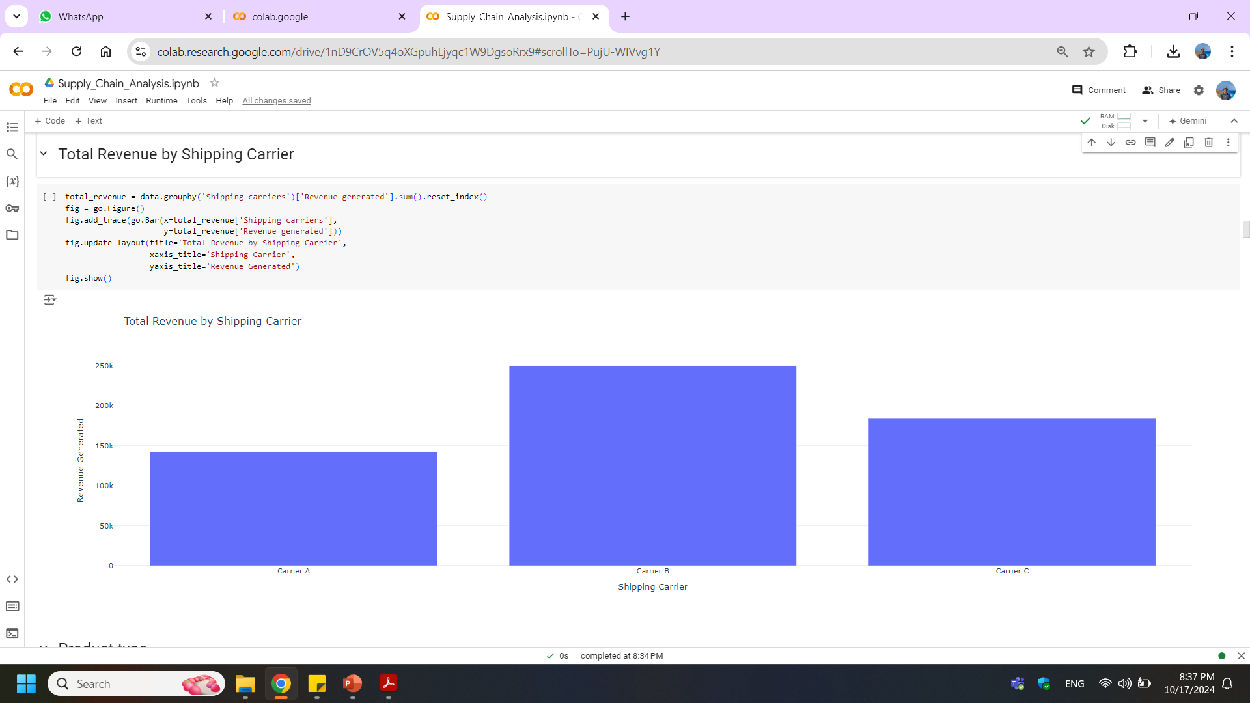
Total Revenue by Shipping Carrier

Slide 23
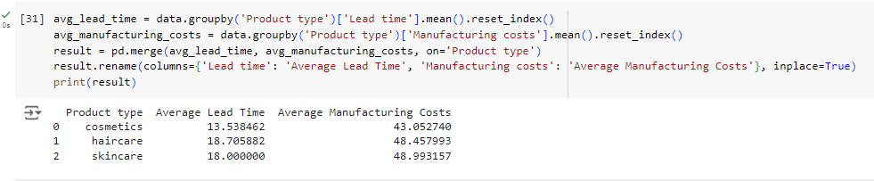
Product type
The company is using three carriers for transportation, and Carrier B helps the company in generating more revenue. Now let’s have a look at the Average lead time and Average Manufacturing Costs for all products of the company

Slide 24
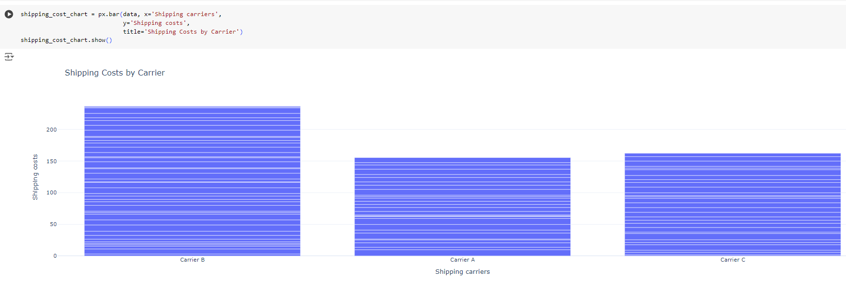
Shipping Costs by Carrier

Slide 25
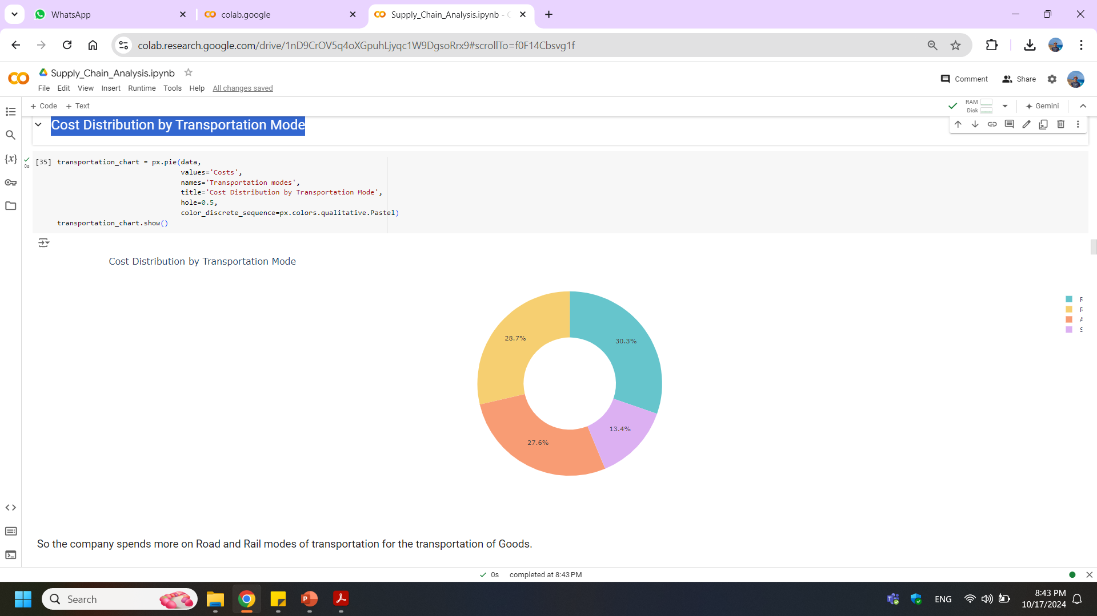
Cost Distribution by Transportation Mode

Slide 26
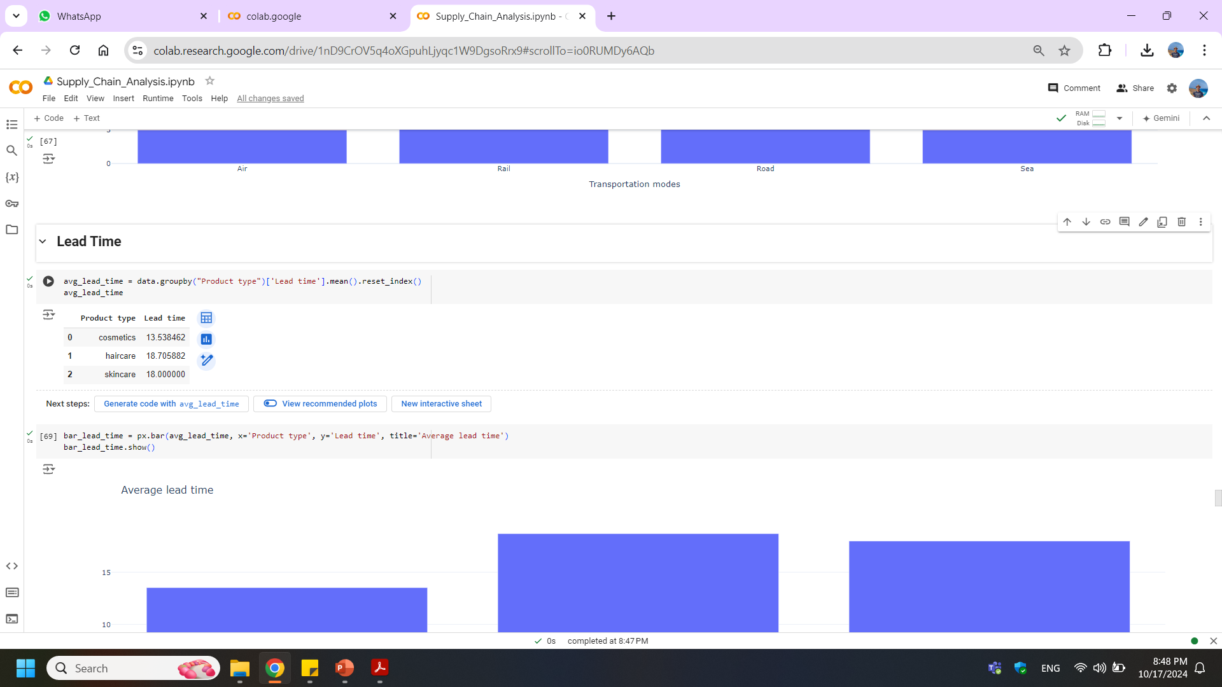
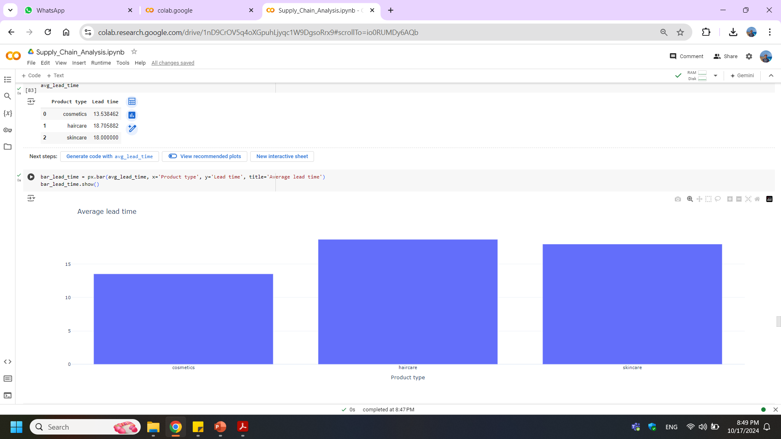
Lead Time

Slide 27
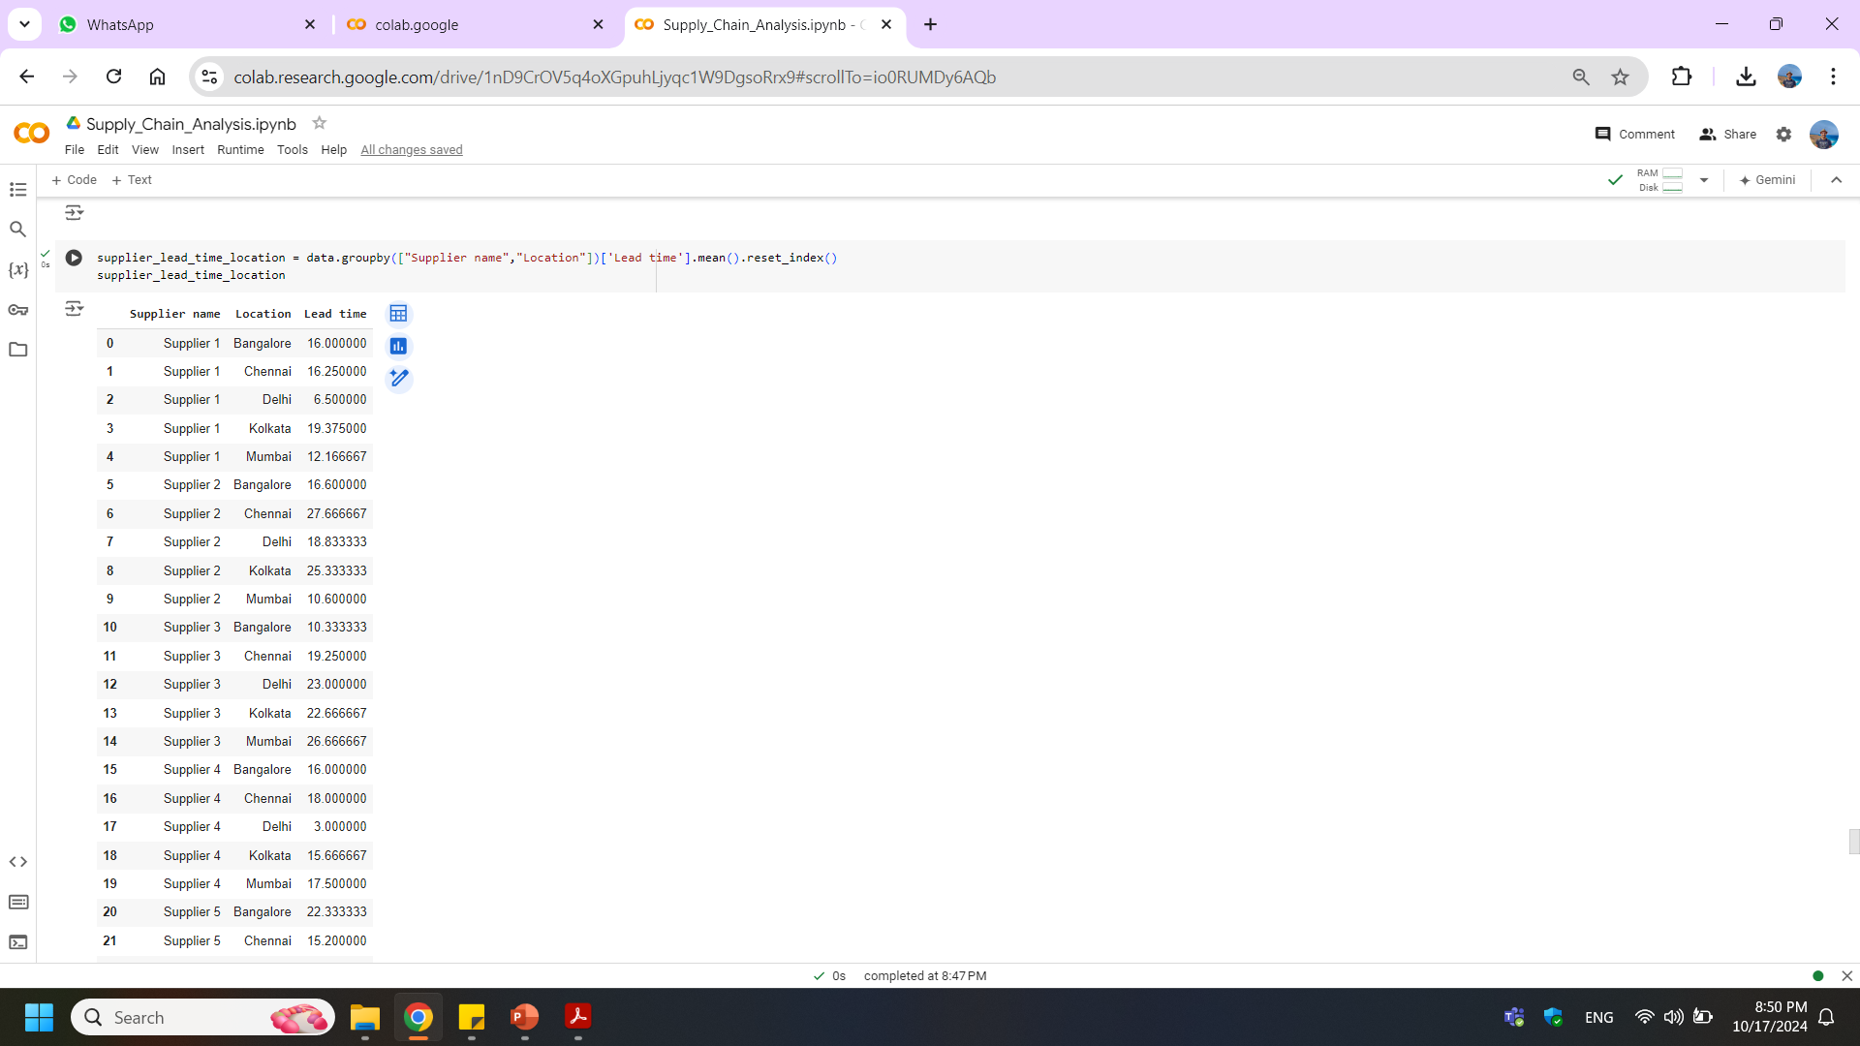
Supplier [ Lead Time & Location]

Slide 28
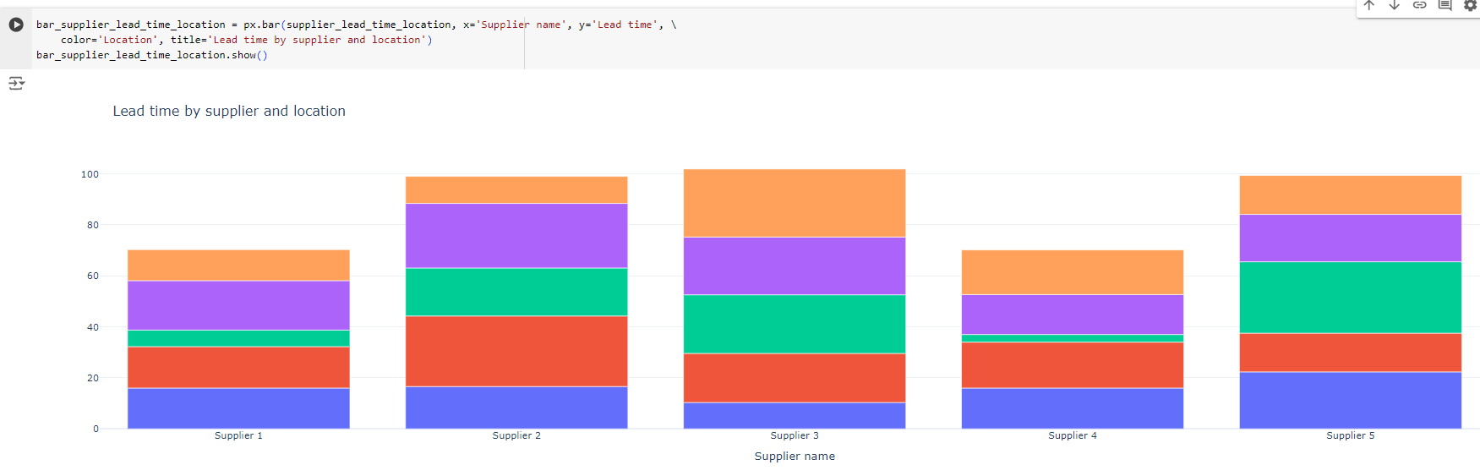
Lead time by supplier and location

Slide 29
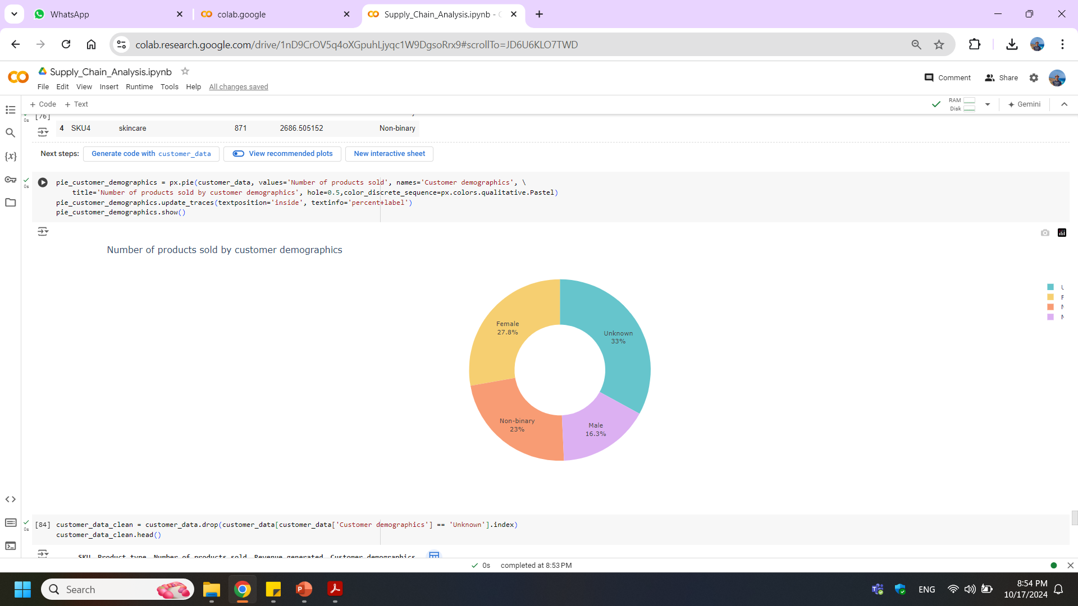
No. of products sold by demographics

Slide 30
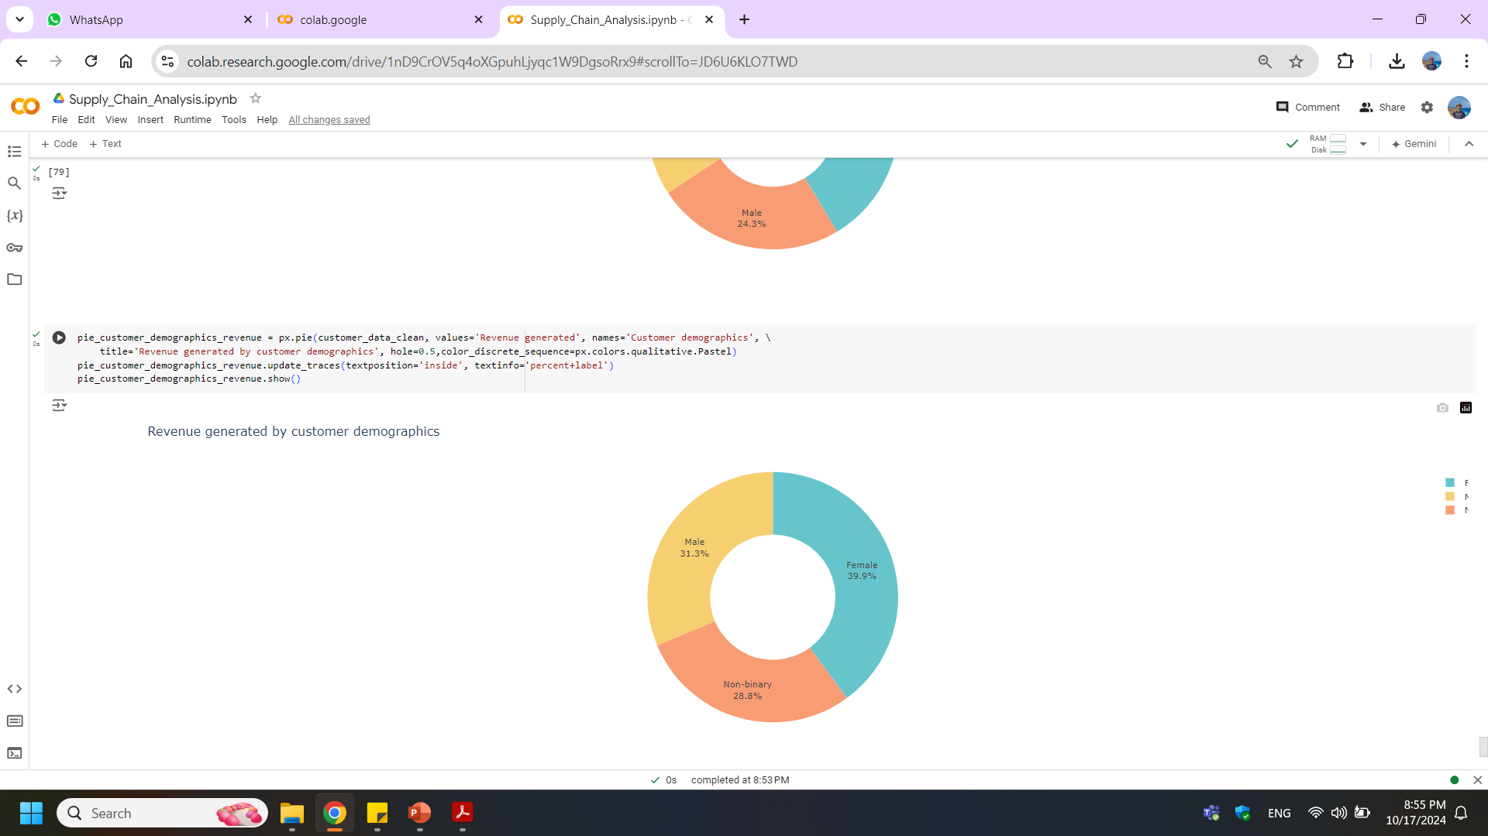
Revenue generated by customer demographics

Slide 31


Slide 32
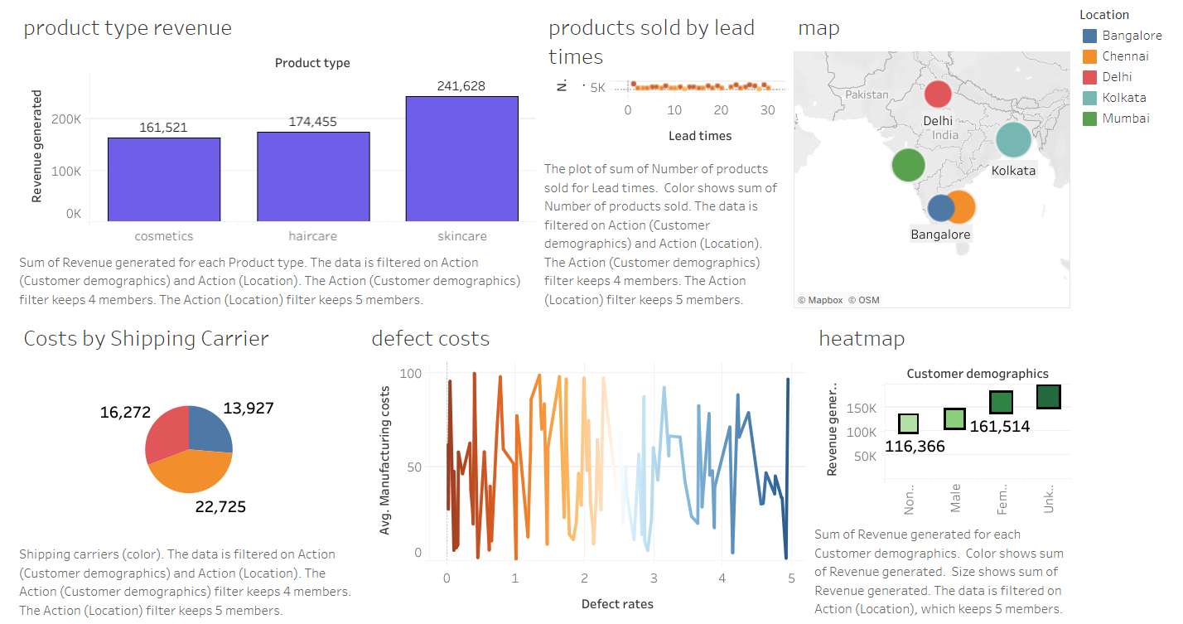

Slide 33
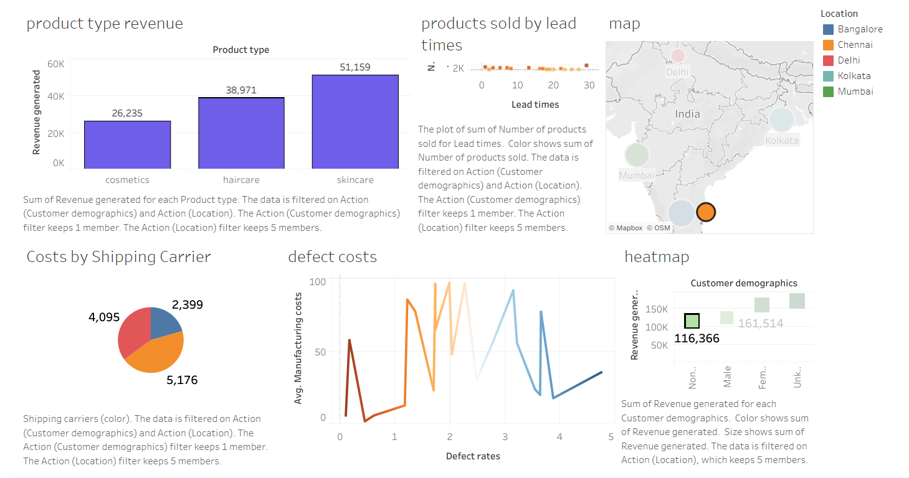

Slide 34

Thank you for your time,
I hope you found this presentation insightful and inspiring.
Prepared & Presented by ..
Ahmed Mohamed Fathy Neamatallah
https://www.linkedin.com/in/ahmedneamatallah
Ahmed Refaat Moussa Makhlouf
https://www.linkedin.com/in/ahmed-refat-045b0711b
Ahmed AbdElMegeed AbdElSattar Maklad
Special Thanks to our instructors ..
https://www.linkedin.com/in/a-maklad
[ Mohannad ElAssal ]
[ Yehia Adam ]
Ahmed Mohamed Ahmed Arram
https://www.linkedin.com/in/ahmed-arram-540b1583

